Slide 1
HOMO

Slide 2
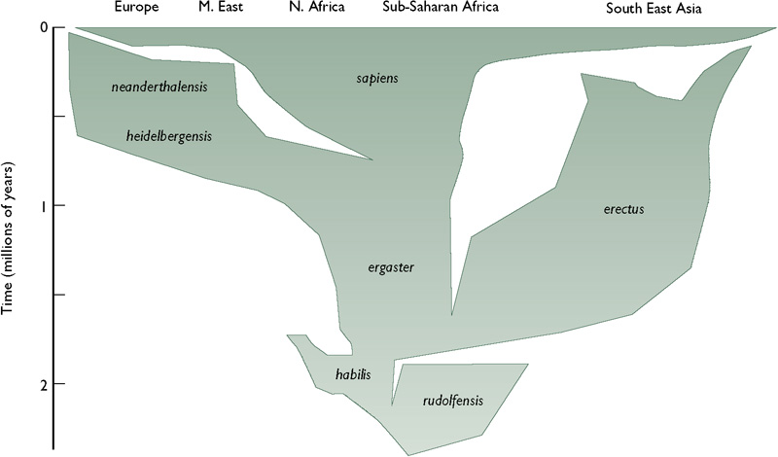
An overview of the evolution of Homo in time and space
Lewin & Foley (2003) Figure 13.1

Slide 3
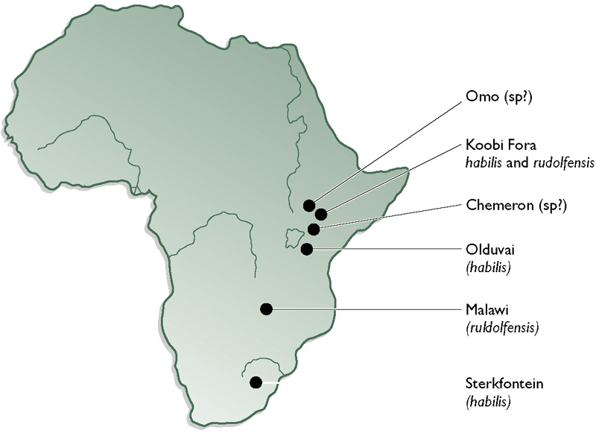
Sites in Africa where early Homo has been found
Lewin & Foley (2003) Figure 11.6

Slide 4
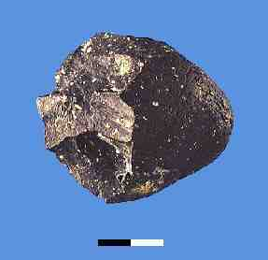
The first tools
From about 2.5 Mya we start to find stone tools in those same areas of Africa where we find hominin fossils.
Any of the hominins could have made the tools.
Coincidentally two new species appear in East Africa.

Slide 5
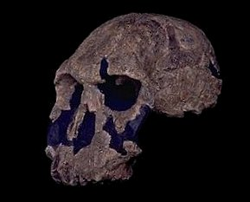
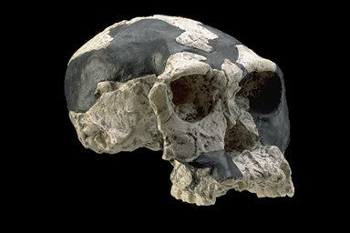
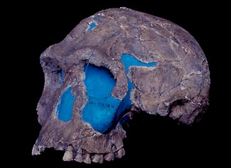
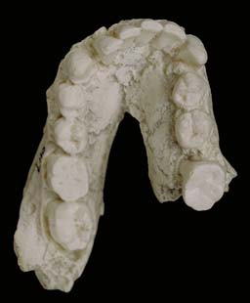
Fossils of early Homo
OH 24
The majority of finds of early Homo have been made in east Africa, principally from Olduvai Gorge and from Koobi-Fora
These are all of a small hominin, with non-megadont teeth and a cranial capacity somewhat larger than the australopithecines. Some have a flat face and others a more concave profile
KNM-ER-1470
OH 7
KNM-ER-1813
Images from http://www.mnh.si.edu/anthro/humanorigins/

Slide 6
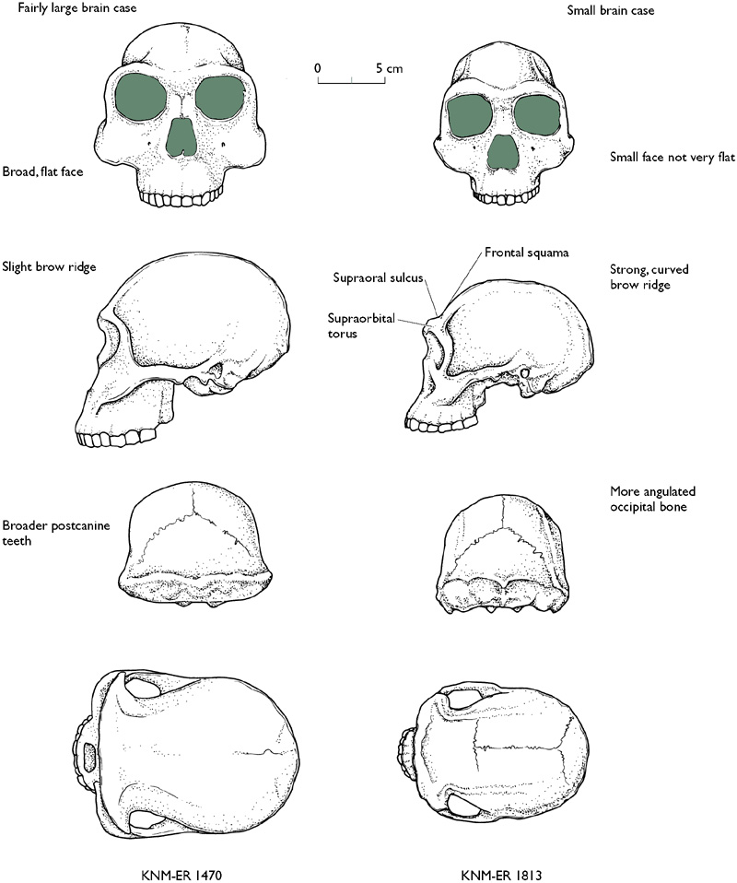
Homo habilis & Homo rudolfensis
rudolfensis
habilis
Both found from about 2 – 2.5 Mya.
Homo habilis from Olduvai & Koobi Fora in East Africa and also from South Africa.
Homo rudolfensis from Koobi Fora but not from Olduvai; also found in Malawi.
Lewin & Foley (2003) Fig 11.8

Slide 7
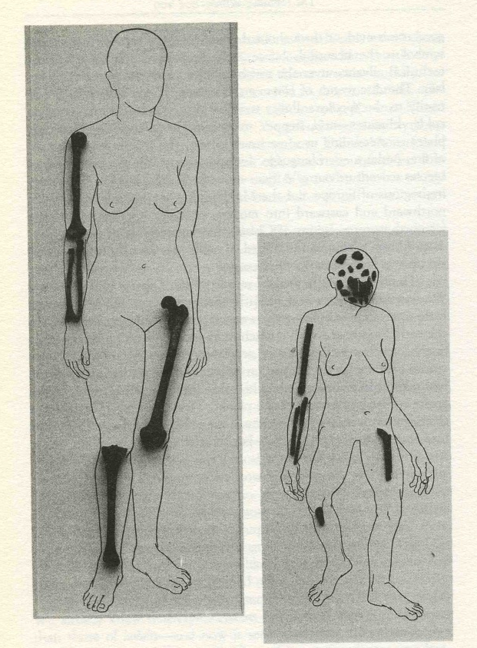
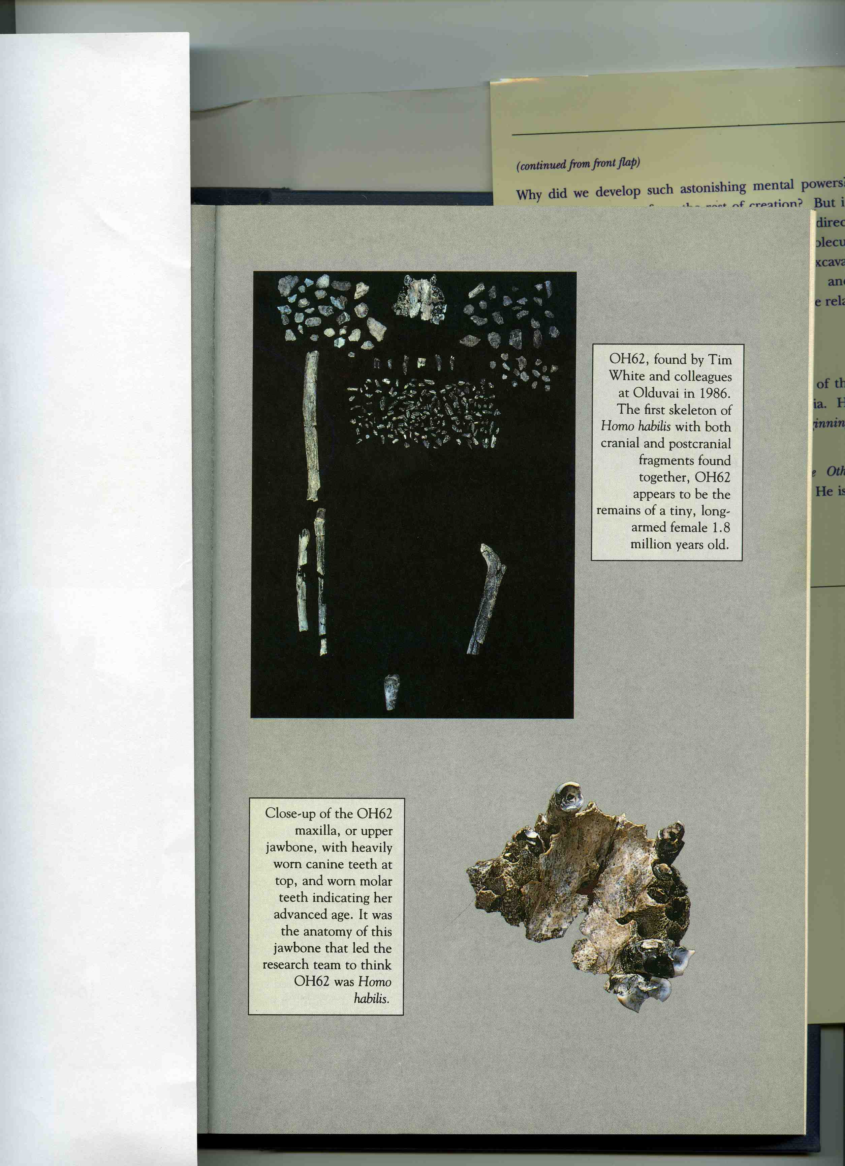
OH62
OH62 compared to a modern human
Images from “Lucy’s Child” by Don Johanson & James Shreeve

Slide 8
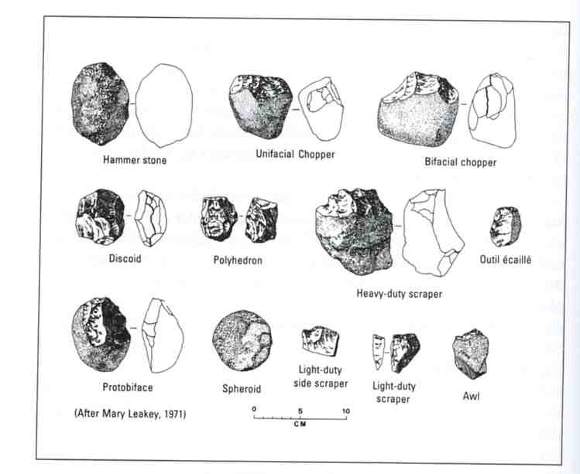
The Oldowan industry
From Schick & Toth (1993)

Slide 9
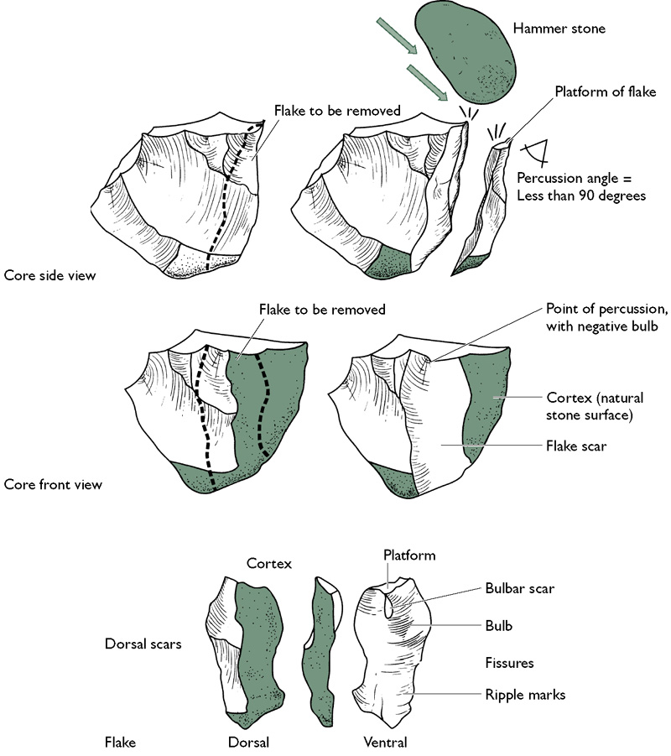
Conchoidal fracture – how to recognise intentionally struck flakes of stone
In order to repeatedly and reliably produce sharp, usable flakes, a core of a suitable, fine-grained or amorphous rock must be struck at an angle of less than 90 degrees (top).
This leaves characteristics features on both the core and the flake (middle and bottom, respectively).
Lewin & Foley (2003) Figure 12.7

Slide 10
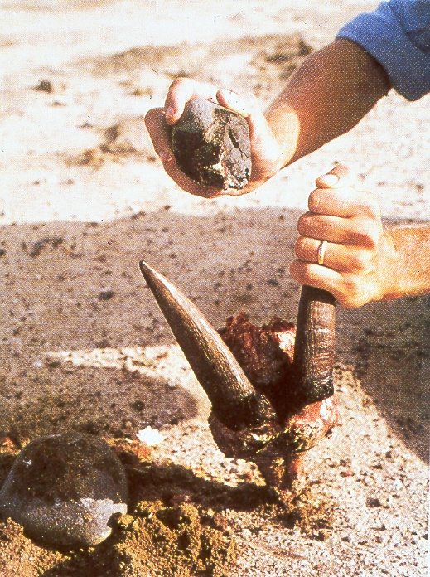
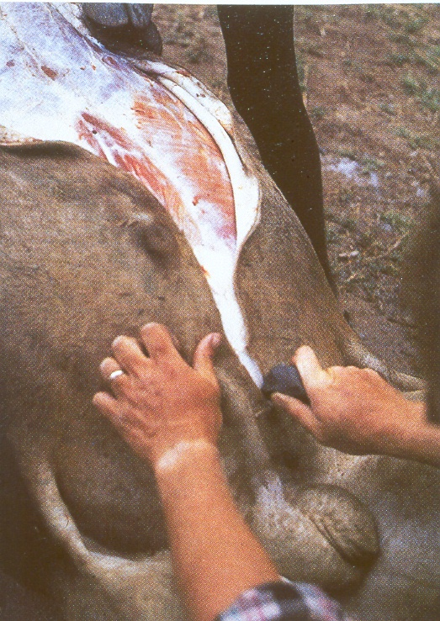
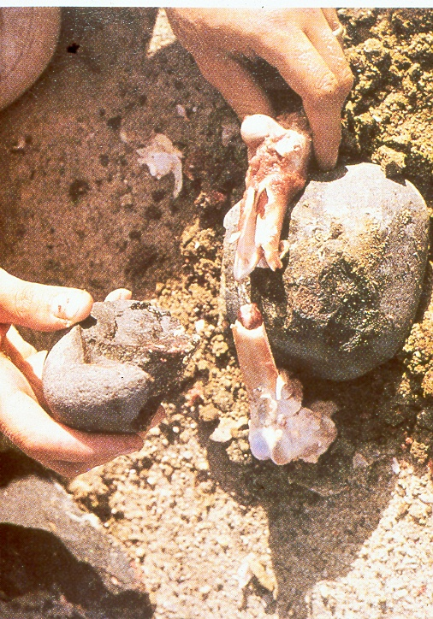
Experiments using Oldowan tools
Getting into the brain case – chopper core
Cutting through hide - flake
Breaking bones for marrow – chopper core

Slide 11
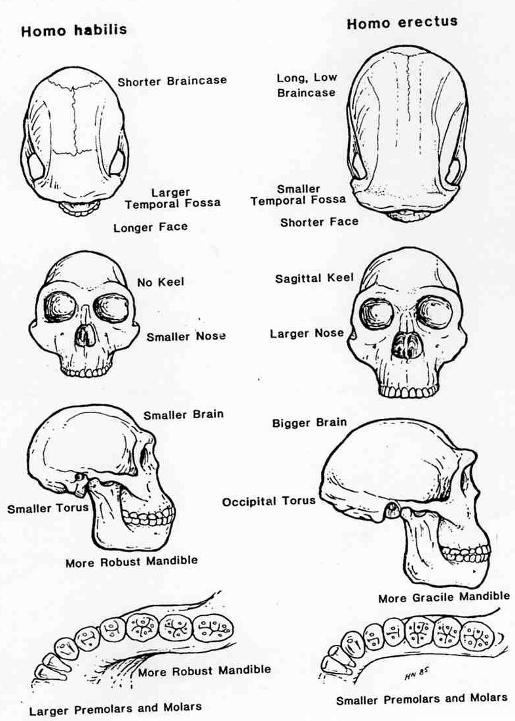
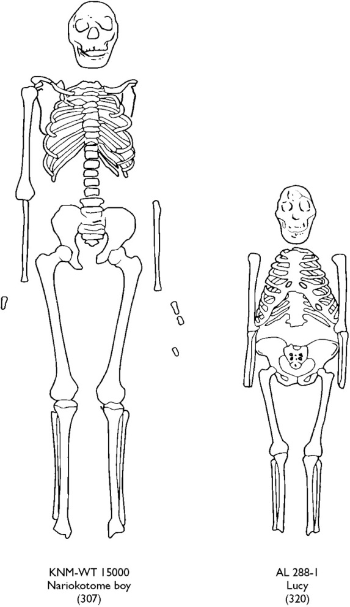
Homo erectus and earlier hominins
H. ergaster
Lucy
Contrasts in the postcranium – from Conroy (1997).
NB we are not certain that H. habilis had the same proportions as Lucy, and we have no postcrania for H. rudolfensis.
Contrasts in the cranium – from Fleagle (1999)

Slide 12
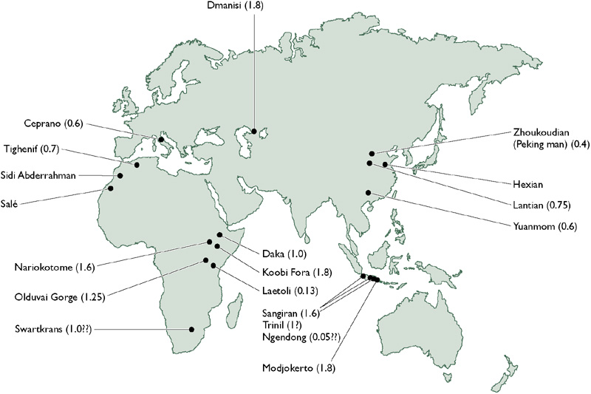
Homo erectus – globetrotter
NB the fossil species found at the earliest African sites is often distinguished as Homo ergaster. This follows this practice, but, as we will see, separating out the African fossils becomes more problematic after I mya.
Lewin & Foley (2003) Figure 13.7

Slide 13
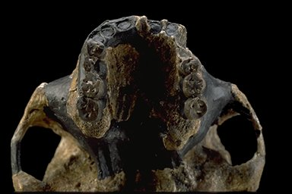
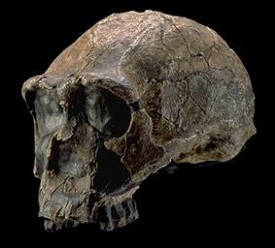
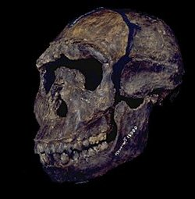
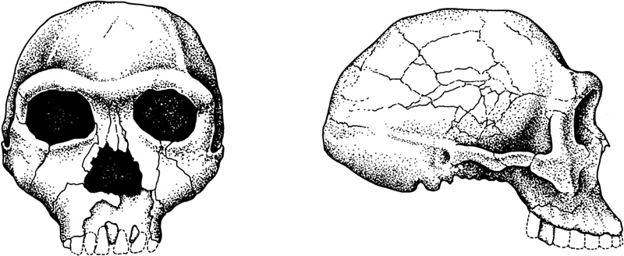
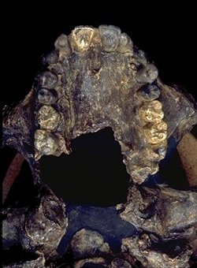
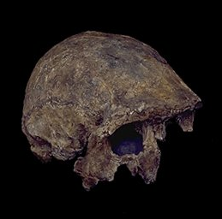
Homo ergaster in Africa
3733
3733
Line drawings of 3733
WT 15000
These fossils all come from the Lake Turkana Basin, Kenya. KNM-ER-3733 is radiometrically dated to 1.8Mya and KNM-ER-3833 is slightly younger. KNM-WT-15000 is about 1.5Mya.
NB not to the same scale.
Photos from http://www.mnh.si.edu/anthro/
humanorigins/
3833

Slide 14
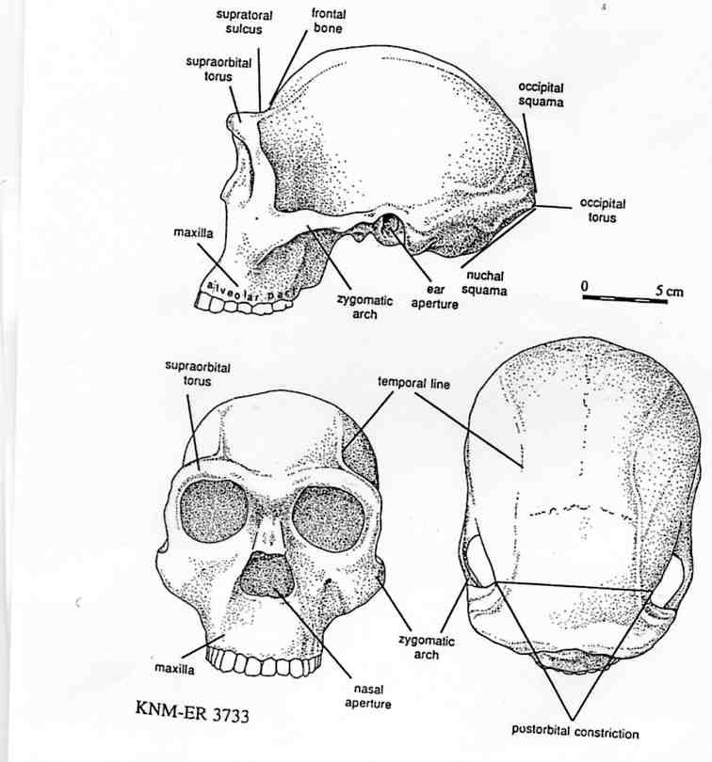
Main features of the Homo ergaster cranium
The skull has a number of features which distinguish it from H. habilis, including a large, forwardly projecting brow ridge and a dip behind this separating it from the low, receding frontal bone.
The braincase is considerably larger than in earlier species of hominins – in this specimen it is estimated at 848cc. The braincase is relatively long, as is particularly evident when it is viewed from above.
From Klein (1999) Figure 5.10

Slide 15
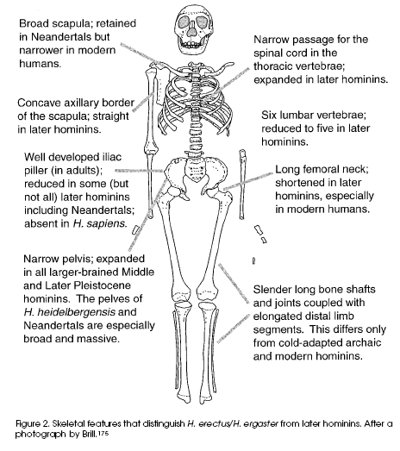
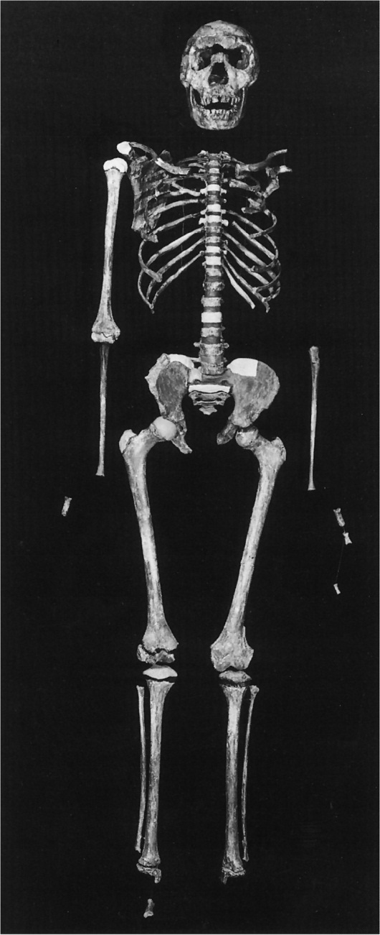
Homo ergaster – the postcranium
Postcranial features which distinguish H. ergaster (and H. erectus) from later hominins – From Pearson (2000) Evol. Anth 9 229-47
KNM-WT-15000. Lewin & Foley (2003) Figure 13.8

Slide 16
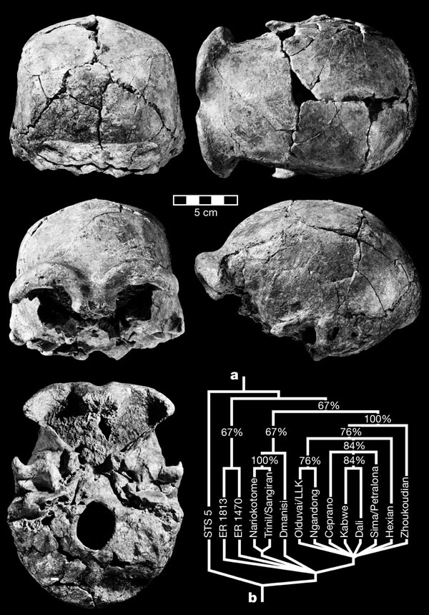
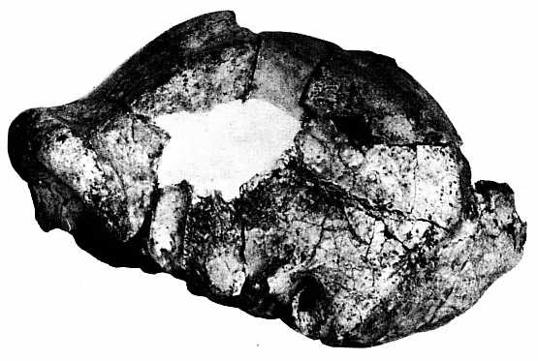
Daka – 1 Mya Homo erectus in Africa
The Daka cranium (BOU-VP-2/66) (left) has an endocranial volume of 995cc. The thick Brow ridges are strongly arched. There is a noticeable dip behind this and the frontal bone is receding. The overall shape of the cranium is relatively long. Somewhat unusually, at the back, there is no obvious occipital torus.
There are some similarities to the earlier, and less complete skullcap of OH9 (above), and the cladograms shown on the left place these together as Olduvai/LLK.
The cladogram does not separate African fossils as being different to Asian fossils. Instead, the main groupings tend to relate more to age.
Asfaw et al (2002) Nature 416 317-319

Slide 17
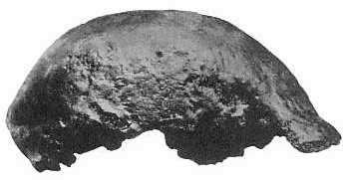
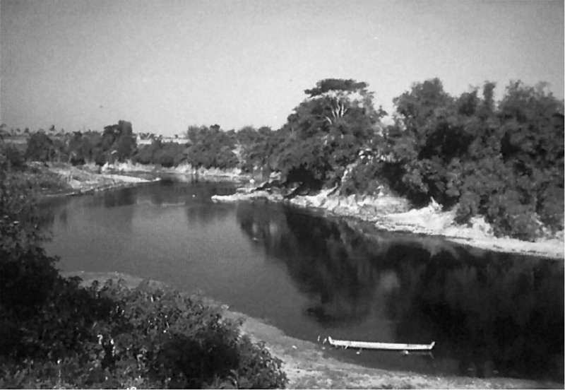
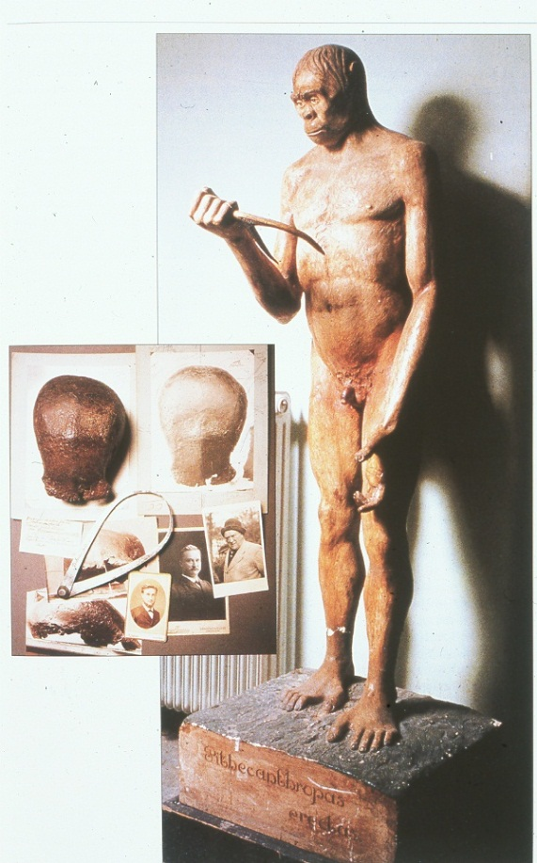
Not just in Africa
Homo erectus was first discovered in the Far East – in Java.
The skull cap from Trinil
Eugene Dubois’ own reconstruction of Pithecanthropus erectus and period photographs.
Trinil – on the Solo river in Java where Eugene Dubois first found Pithecanthropus erectus in the early 1890’s

Slide 18
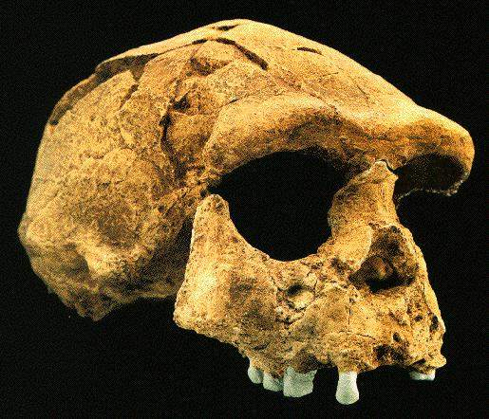
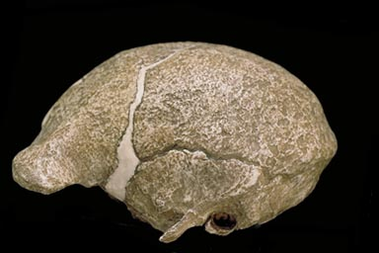
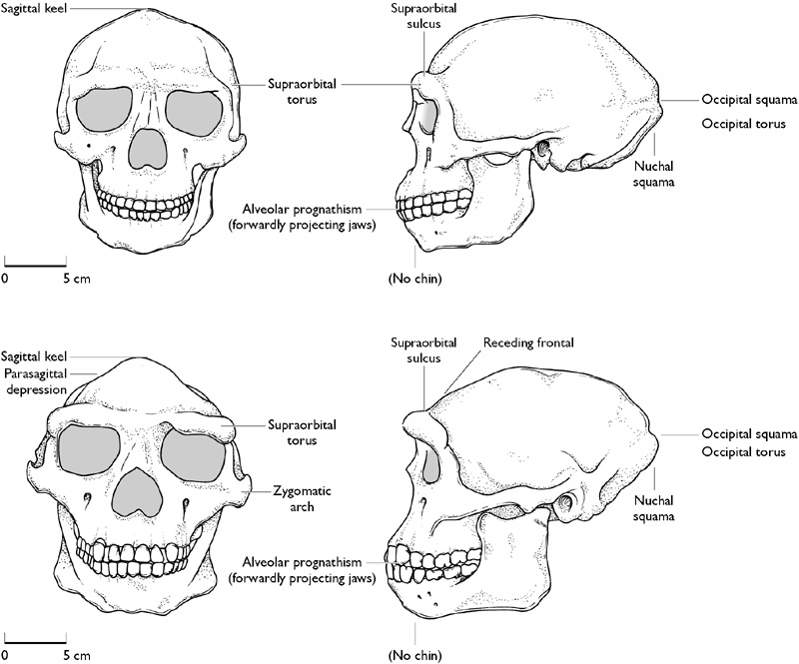
Javan Homo erectus
Two of the finds from Sangiran.
Left: Sangiran 17
(image from http://www.talkorigins.org/
faqs/homs/)
Right: Sangiran 2
(image from http://www.mnh.si.edu/
anthro/humanorigins/)
Drawings of Weidenreich’s reconstructions of Javan Homo erectus, showing the distinguishing features.
Lewin & Foley (2003) Figure 13.6

Slide 19
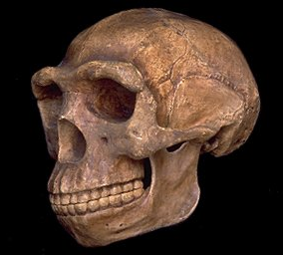
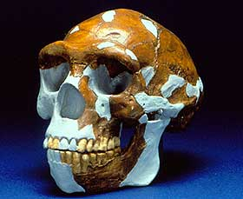
Interpretations of “Peking Man”
The original fossils from Zhoukoudian were lost in World War II, but reconstructions (left) by Weidenreich, as well as more detailed casts, had been sent to the United States.
Recently Ian Tattersall and colleagues have made a new reconstruction of one of the skulls from Zhoukoudian (right).
(Image from http://www.mnh.si.edu/
anthro/humanorigins/)
(Image from http://www.naturalhistorymag.
com/0204/0204_feature.html)
Drawings of Weidenreich’s reconstructions of Zhoukoudian Homo erectus, showing the distinguishing features.
Lewin & Foley (2003) Figure 13.6

Slide 20
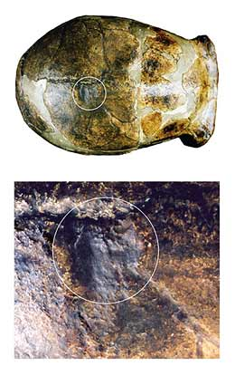
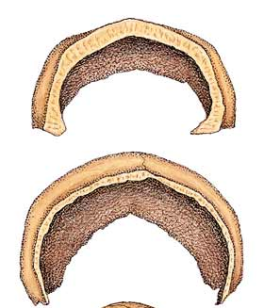
Why does Homo erectus have such a thick skull?
The thick walls of the cranium in H. erectus are markedly different from both earlier and later hominins. Such a robust skull is not easily explained by the biomechanics of chewing – the usual explanation for differences in hominin skulls.
One unusual feature of the skulls is the sagittal keel, a thickening of the midline of the skull. This wasn’t for muscle attachment, but it is possible that it was a defence against injury – and the pictures (right ) show a healed injury (a depressed fracture) in just this region on one of the Peking skulls and originally pointed out by Weidenreich.
Did H. erectus lead a violent life? Is this evidence for sexual competition and selection? Did the cost of carrying a heavy skull contribute to the eventual extinction of H.erectus in the Far East?
The bones of the vault of the skull are much thicker in Homo erectus (top) than in H. sapiens (bottom).
From Boaz & Ciochon (2004) Headstrong Hominids. http://www.naturalhistorymag.com/0204/0204_feature.html

Slide 21
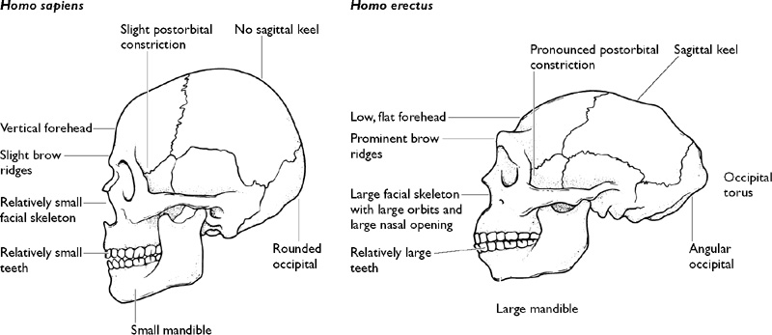
Comparison of modern humans and “classic” Homo erectus
The drawing of Homo erectus used here is based primarily on the fossils from the Far East (Java and China) – hence the term “classic”. As we learn more about the variation within H. erectus such broad, overall comparisons become more difficult to draw.
As well as the features labelled, it is notable that only H. sapiens has a clearly developed chin.
Lewin & Foley (2003) Figure 13.11

Slide 22
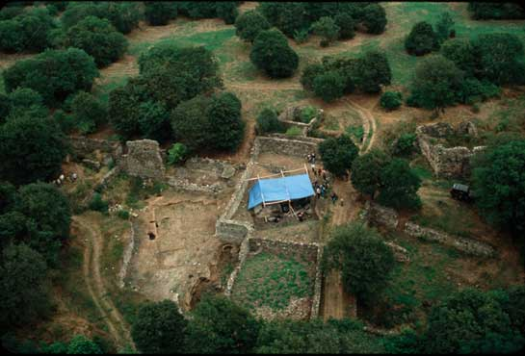
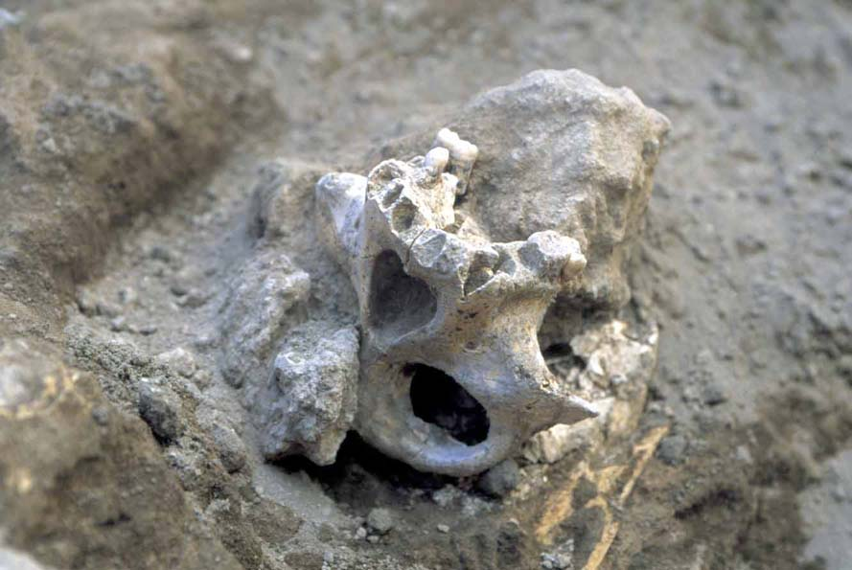
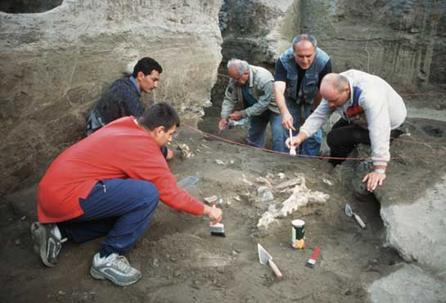
Dmanisi – an enigma at the gates of Europe
Aerial view of the deserted medieval village – but the excavation found layers dating to 1.8Mya – complete with sabre-toothed cats, giraffes, ostriches, rhinos, wolves, deer – and at least 6 hominins
Pictures from National Geographic and Dmanisi web-site

Slide 23
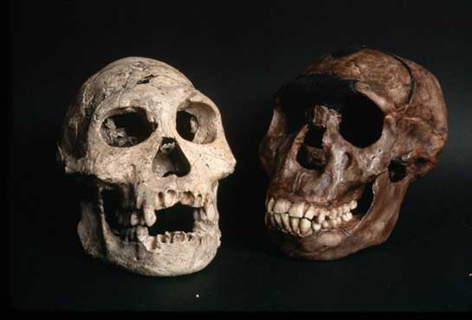
What species is present at Dmanisi?
This compares two adolescent skulls - D 2700 (Dmanisi) and WT 15000 (Nariokotome) which is ascribed to Homo ergaster. Like other Dmanisi hominins, D 2700 is notably small and quite lightly built. Some consider them to resemble H habilis and/or H. rudolfensis. The proposal has also been made that the Dmanisi hominins are a distinct species – H. georgicus.
Picture from National Geographic

Slide 24
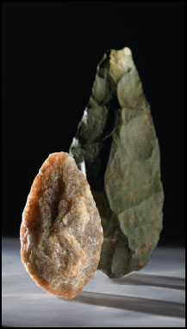
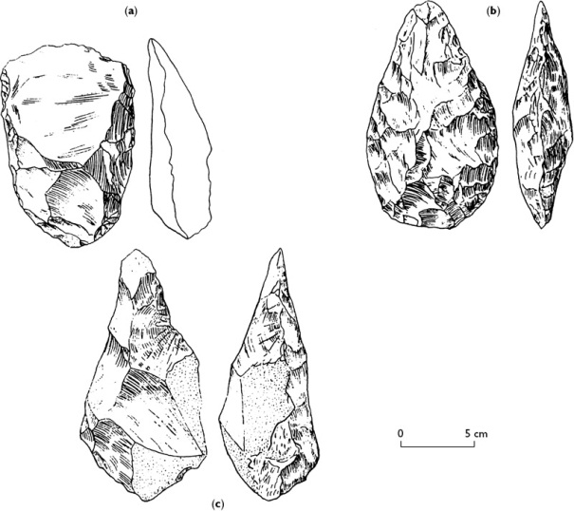
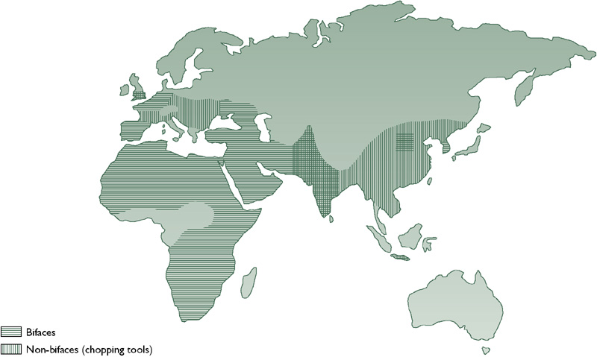
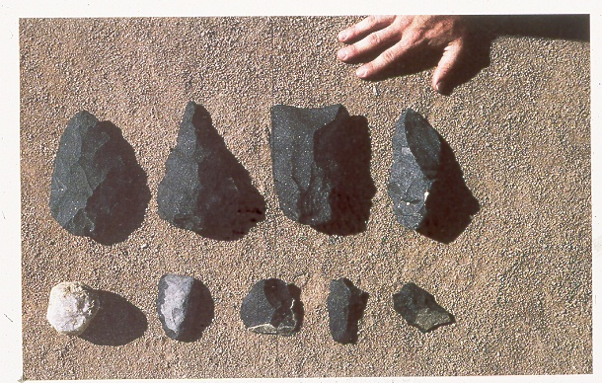
The Acheulean industry
Left: Drawings of African Acheulean bifaces and photograph of two in the collection of the British Museum. The key innovation of the Acheulean industry was the ability to work on both sides of cores, or large flakes, to produce particular shapes.
Below: the global distribution of the Achuelean (biface) industry shows it to be principally confined to Africa, Western Asia and Europe. The timespan is approx. 1.5Mya to 0.5Mya.
Modern replicas of Acheulean tools made by Nicholas Toth.

Slide 25
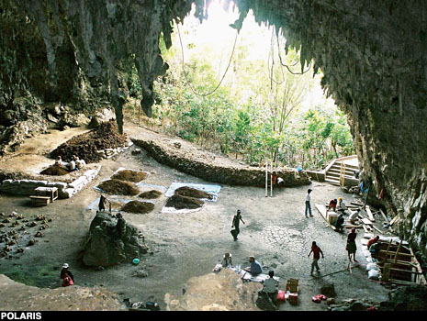
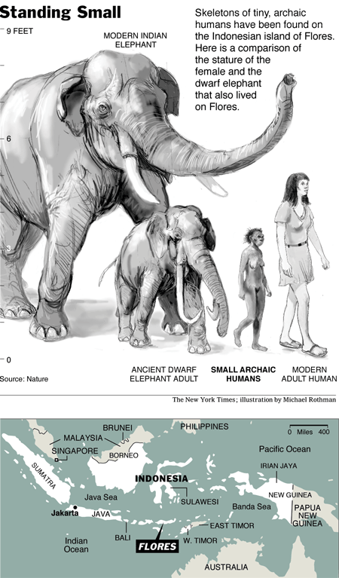
A surprise from a cave on Flores
Flores has probably always been separated from the mainland of South-East Asia, even when sea-levels were at their lowest.
The complex biogeography of this area is shown in the number of endemic species, past and present.
But no-one would have predicted what was found ..

Slide 26



Homo floresiensis
The skull is more like Homo erectus than anything else. The overall cranial shape is low and long. The jaw lacks a chin.
The rest of the skeleton is that of a biped – although the pelvis is rather reminiscent of the Australopithecines.
This is a tiny hominin – estimated height about 1 metre.
The bones are found in the same layer as the bones of a dwarf elephant (Stegodon).
The bones are found in the same layer as relatively sophisticated stone tools.
The date is c. 18,000 bp

Slide 27


Flores challenges assumptions
The brain size of Homo floresiensis was estimated at 380 ml. CAT scan studies by Dean Falk increased this estimate a little, and showed the shape of the brain.
Compare brain size to body size and we have a member of genus Homo with a brain which appears to be relatively smaller than that of the Australopithecines.
And yet we appear to
have a tool-maker.

Slide 28

A descendant of H. erectus – globetrotter?

Slide 29

The story so far ..
The known fossil record of hominids, including S. tchadensis, also showing ourselves (top left) and the chimpanzee (top right). NB The species marked with an asterisk were all unknown a decade or so ago.
Species are assigned to one of four categories, based on brain and cheek-tooth size, and inferred posture and locomotion. A fifth category is for 'insufficient evidence'.
Wood, B. (2002) Palaeoanthropology: Hominid revelations from Chad Nature 418, 133–135

